Slide 1
“Gleeful Cruelty”: Trump’s Presidential Speeches and Approval Rating
Brian Pennington

Slide 2
Motivation for Project
President has worst approval ratings of any President
Media has been hyper-focused on his every move
Presidency represents another step in political polarization
Represents a drastic contrast to any previous President:
Tone
Rhetoric
Attitude
Experience
Controversy

Slide 3
Question:
Is there aspect in the President’s message or rhetoric that can explain why this has been one of the most divisive presidencies in American history?

Slide 4
Methods
Used approval ratings from FiveThirtyEight
Aggregates and weights ratings from all over
Scraped Trump speeches from American Presidency Project
Clean speech data:
Eliminated stop words and punctuation
Tokenized single words using sklearn CountVectorizer
Counted words shared with a corpus
Sentiment: nrc and bing corpora
Policy: created our own

Slide 5
Features:
Sentiment
Policy
Positive
Negative
Trust
Fear
Anger
Sadness
Joy
Anticipation
Surprise
Disgust
Women’s Rights
Constitution Issues
Social Issues
Environmental
Military/Defense
Foreign Relations
Healthcare/Welfare
U.S. Economy
Features represent proportion of words for a given time window

Slide 6
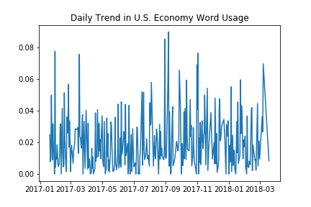
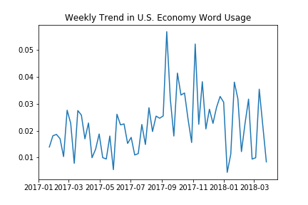
Trends
Daily and weekly trends
Incredibly noisy data
Most features vary around a given point in daily trends
Weekly trends indicate slight changes in President’s focus

Slide 7
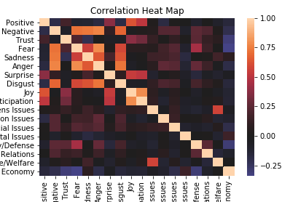
Clusters
Correlations between features outline these rhetoric clusters
Sentiment & Sentiment:
Positive Cluster: Positive, Joy, Surprise, Anticipation
Negative Cluster: Negative, Fear, Anger, Sadness, Disgust
Policy & Policy
Women’s Rights and Healthcare/Welfare
U.S. economy and Military/Defense (Negative)
Foreign Relations and Military/Defense *
Policy & Sentiment
U.S. Economy and Trust & Fear
Military/Defense and Negative, Fear, & Anger
Constitutional Issues and Anger

Slide 8

Gleeful Cruelty

Slide 9
Prediction and Modeling
Predicted using Random Forrest Regression:
Ratings and change in ratings for the same day
Ratings and change in ratings for the day after speeches
Ratings and change in ratings for the same week
Ratings and change in ratings for the week after the speeches
Performance:
Average RMSE for ratings: 3 – 3.5
Average RMSE for change in ratings: 1.25 – 1.5

Slide 10
Evaluation
Not super accurate
Approval rating varies by 10 points
Disapproval rating varies by 16
Changes vary by 6
Fairly decent size error ( 1/3 – 1/5)
Indicative of underfitting model
Most likely due to poor or noisy features

Slide 11
Conclusion
Trump’s ratings won’t change drastically after a single speech
Most opinions on him are solidified
Action, more than words, would lead to changes in ratings

Slide 12
Acknowledgements
FiveThirtyEight: For their open access to approval rating data set
American Presidency Project: For allowing to scrape Trump’s speeches
Mentor, Misael, for guiding me along this project

